Slide 1
American History Chapter 1 –

Slide 2
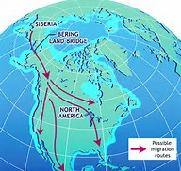
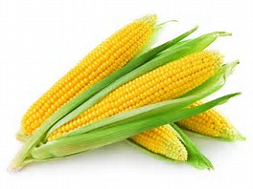
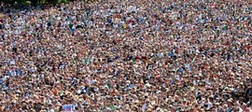
I. The Native American Experience
The First Americans
Many people came to the Americas via the Bering Straight
-6000 B.C.E – Indians began raising crops- maize
- helped encourage population growth (especially in present day Mexico).

Slide 3
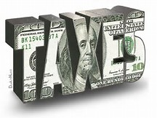
I. The Native American Experience
American Empires
Aztec Empire – Tenochtitlan was the capital
Established trading routes throughout the empire
Used tributes – Payments (taxes)
Chiefdoms & Confederacies
Maize becomes major crop in Central and N. America
Mississippi Valley
Eastern Woodlands – Villages built around maize fields
Women were in charge of crops and other community affairs
Iroquois were a matriarchal society- power based on female families
Great Plains and Rockies – Hunted Buffalo, lacked resources made many Indians nomadic
Arid Southwest – based on agriculture (maize) and built elaborate irrigation systems (Pueblo Indians)
Pacific Coast – Chinooks were strong warriors, relied heavily on fishing ; built elaborate canoes

Slide 4
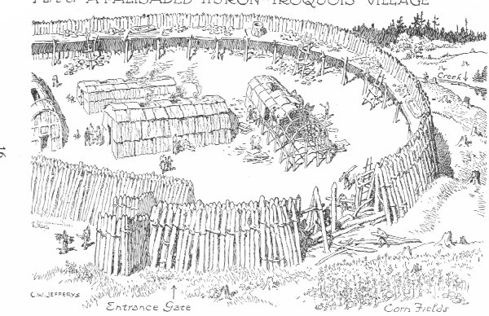
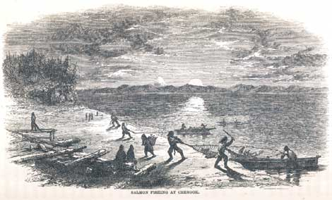
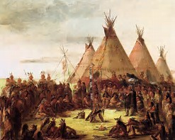
Matching Game Match the Tribe with the Picture

Slide 5
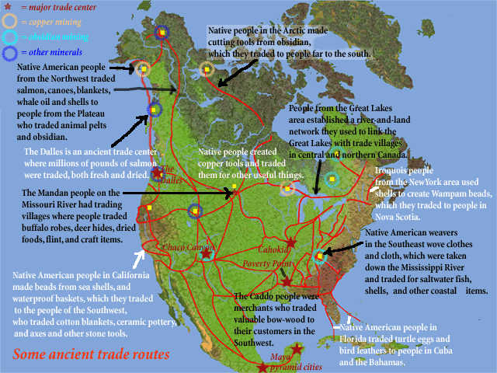
The Native American Experiment Cont.
Patterns of trade
Many Indians traded with each other throughout the Americas
Trade fairs between nomadic Navajos & Pueblos in the southwest
Maize traded for meat, furs, and other supplies
Sacred Power
Animism- Religion associated with nature
Indians respected animals they hunted by performing rituals
Nothing to do with Animism but this one is Awesome

Slide 6
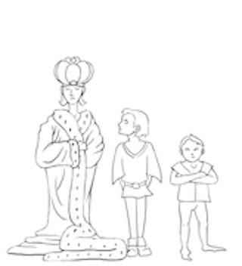
Western Europe : The Edge of the Old World
Hierarchy and Authority:
European families were patriarchal- property & wealth was on male families
Females gave up many rights when married – name, property, expected to submit to husband
Primogeniture – eldest son inheriting most of wealth
Later encouraged immigration to colonies

Slide 7
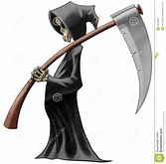
Western Europe : The Edge of the Old World Cont.
Peasant Society:
Poor individuals, mostly farmers; made up most of the immigrants to Americas
Half of the children died before 21.
Expanding Trade Networks:
Merchant cities began to grow drastically
Guilds helped to regulate trade

Slide 8
Western Europe : The Edge of the Old World Cont.
Myths, Religion and Holy Warriors
Roman Catholic Church had tons of power in Western Europe
Individuals involved in heresies (ideas inconsistent w/ Christianity) were persecuted

Slide 9
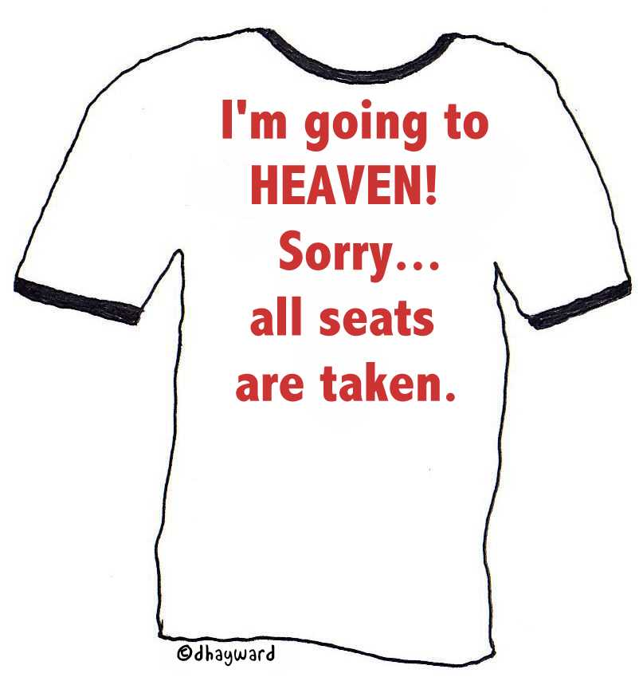
Western Europe : The Edge of the Old World Cont.
Reformation
Martin Luther & his 95 Theses- Protested the sale of indulgences (paying for sins)
John Calvin and Predestination
Predestination – God determines prior to birth whether you will be saved
England became a Protestant Nation
The Reformation weakened the strength of Catholicism in Europe

Slide 10
West & Central Africa: Origins of the Atlantic Slave Trade
Empires, Kingdoms, and Ministates:
Most of the African Slave Trade was based out of West Africa
Kings & Princes were regarded as Divine
Ghana, Mali, and Songhai Empires- used extensive trade Routes
Used the military to control trade routes- GOLD!
The Spirit World
Islam spread over trade routes in Africa
Many Africans still practiced versions of Animism and were polytheistic

Slide 11
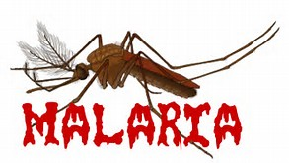
Exploration & Conquest
Portuguese Expansion:
Portugal had an extensive role in Exploration and African Slave Trade
Trading post were established in W. Africa
Europeans had little luck exploring interior of the African Continent:
Malaria, and interior was well defended
The African Slave Trade :
- Slavery was widespread throughout Europe
- Slaves were used on sugar plantations
- Mid-1600th century, African Slave Trade expanded drastically and used in S. America.

Slide 12
Exploration & Conquest Cont.
Sixteenth – Century Incursions:
Reconquista- Spanish Catholics trying to get rid of Muslims in Europe
Also led an Inquisition against alleged Christian heretics ( Some even burned alive)

Slide 13
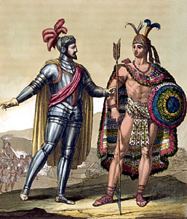
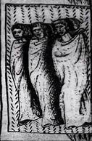
Exploration & Conquest Cont.
Spain in the Western Hemisphere:
Conquistadores- Spanish conquerors
Hernan Cortes- led 600 men to defeat the Aztecs at Techochtitlan
Many of the Aztecs were defeated not by the military but rather disease. (Smallpox)
Francisco Pizarro : defeated the Incas in Peru

Slide 14
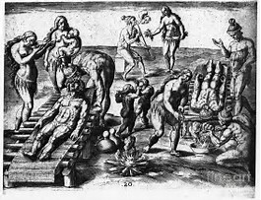
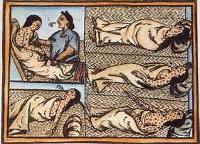
Exploration & Conquest Cont.
Effects of the Spanish Invasions:
Disease and war killed many Indians
- 20 million Indians in 1500 to 3 million in 1650.
Portugal focused on conquering Brazil

Slide 15
The Recap
Importance of Crops (Maize)
Know Native Populations – Northeast, Plains, Southwest, Pacific Northwest.
Differences- Food Source, Religion, Gender roles

